Slide 1

Copyright of ai
yUE yu & Chunyu luo

Slide 2
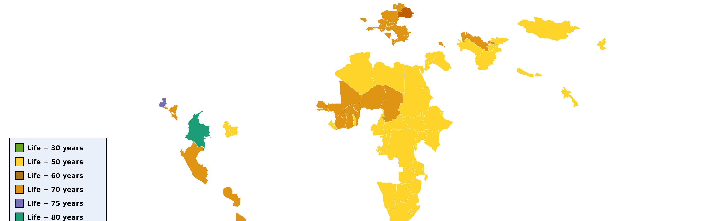
AI copyright approaches across different countries

Slide 3
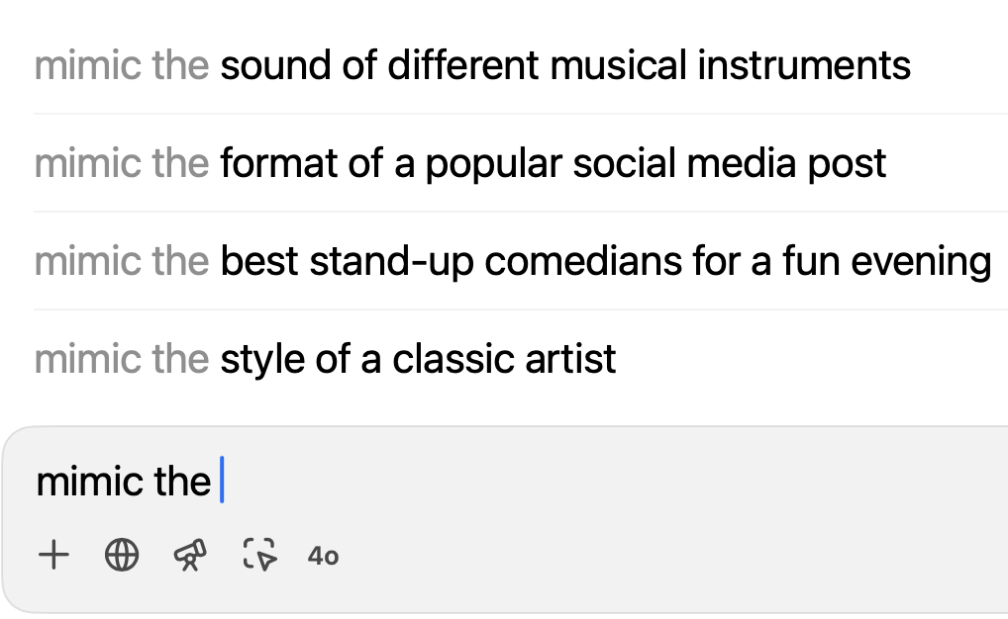
Who owns the copyright to literary works created by ai?
AI definition: computer systems that can perform tasks that would typically require human intelligence, such as language processing, decision making, and problem solving.
AI has been used to create various types of literature works: poetry, fiction, news articles, academic papers, GPT, etc.
Concerns: ownerships and copyrights
How EU, US, and China address this issue and
consider the implications of these approaches
for the future of copyright
Promoting innovation VS Protecting intellectual property
Notes:
In recent years, AI has been increasingly used to generate a wide range of literary works—from poetry and fiction to news articles and even academic papers. A notable example is the AI model GPT-4, which can produce human-like text with a level of sophistication that is often indistinguishable from that of a human author. This remarkable capability has sparked growing concerns around the ownership and copyright protection of literary works created by AI.
This surge in AI-generated works has introduced a significant challenge in the field of intellectual property law: who holds the copyright for literary works created by AI?
Before delving into the legal landscape, it is important to define AI and its growing role in literary creation. AI refers to computer systems capable of performing tasks that typically require human intelligence, such as language processing, decision-making, and problem-solving. These systems rely on algorithms and statistical models to learn from vast datasets and continually improve their performance.This autocomplete snapshot is a subtle but powerful illustration of how AI is being trained to emulate various human styles, formats, and expressions. It also raises important questions: when AI can mimic so much of our creative work—who is the real author? And who owns the result?
In this presentation, I will explore the regulatory landscape of AI and copyright in three major global economies: the European Union (EU), the United States (US), and China. I will examine the legal frameworks and key court decisions that have emerged in response to this issue, highlighting both the similarities and differences in each region’s approach.

Slide 4
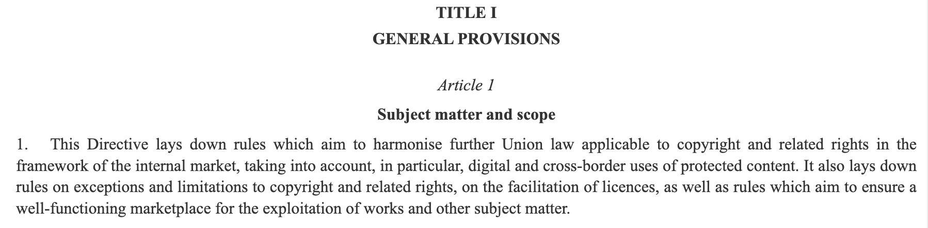
EU copyright laws: COPYRIGHT DIRECTIVE IN 2019
Directive (EU) 2019/790 on copyright and related rights in the Digital Single Market (European Parliament & Council, 2019)
Aim of the Directive:
modernize and harmonize copyright laws across EU member states
reflect the growing importance of digital technologies and online platforms in the creation and distribution of copyrighted works
Notes:
Let’s start by examining how the European Union is addressing this challenge. The European Union has been a leader in developing laws and policies to address the challenges posed by Artificial Intelligence across various sectors—including the realm of intellectual property.
The primary legal framework for copyright in the European Union is the Copyright Directive, which was updated in 2019. This Directive aims to modernize and harmonize copyright laws across all EU member states. It also reflects the growing importance of digital technologies and online platforms in the creation and distribution of copyrighted content.
[read article 1]
As you can see from Article 1 of the Directive shown here, it lays down rules to facilitate a functioning internal market, with particular attention to digital and cross-border uses of protected content. It also introduces new measures around copyright exceptions, licensing, and ensuring a well-functioning marketplace for the exploitation of works.

Slide 5
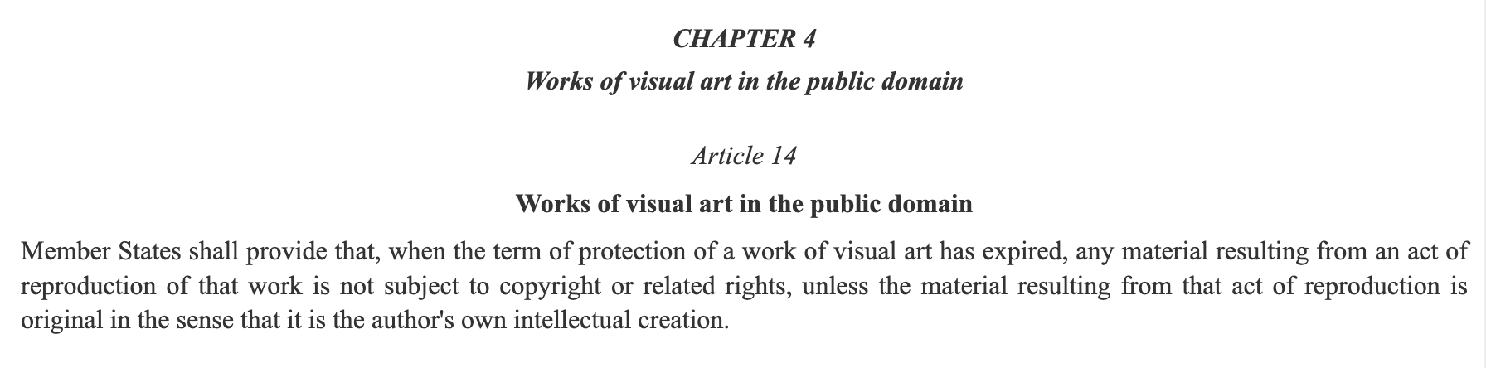
EU copyright laws: COPYRIGHT DIRECTIVE IN 2019
Directive (EU) 2019/790 on copyright and related rights in the Digital Single Market (European Parliament & Council, 2019)
Copyright protection is granted to original literary works, including those created by AI algorithms, provided that they meet the criteria of originality and creativity.
Traditional ownership: the natural person who created the work
Problem: did not specify to who owns the copyright of AI
AI authorship (under review): owned by the developer or user of the AI system, rather than the user of the AI system
Notes:
Let’s now turn to the question of AI-generated content and how it fits within the European Union’s copyright framework.
Under the 2019 Copyright Directive, copyright protection is granted to original works, including those created with the assistance of AI, as long as they meet the standard criteria of originality and creativity. In this regard, AI-generated works can qualify for protection—but only if a human creative input can be identified.
This leaves us with a legal grey zone: Should the copyright go to the developer of the AI system? The user who prompted it? Or should such works be left unprotected, falling into the public domain?
There is currently no unified rule across EU member states. Ownership is likely to be determined based on traditional legal interpretations—which often default to the human who contributed original intellectual effort.
[read article 14]
Now, Article 14 here adds an interesting twist. It confirms that once the copyright of a visual artwork expires, faithful reproductions of that work—such as scans or photographs—are not protected again by copyright, unless there’s some new, original contribution.
This could impact AI-generated “remixes” of public domain art. If the AI system is simply mimicking, and there’s no human originality involved, then the output may not qualify for new protection.
So, while the EU Copyright Directive brings needed modernization, especially for the digital era, it leaves open major questions about AI authorship and ownership—questions that courts and policymakers will likely confront more directly in the coming years.

Slide 6
EU Case 1: Paintings Generated by AI
Decided by: High Court of England and Wales in 2018
Case brief: a group of artists used an AI algorithm to create paintings, which were then exhibited and sold
Core legal question: If the paintings were created by AI without direct human authorship, can they be protected by copyright? And if so, who owns the copyright?
Section 9(3) of the UK Copyright, Designs and Patents Act 1988 (CDPA):
In the case of a literary, dramatic, musical or artistic work which is computer-generated, the author shall be taken to the person by whom the arrangements necessary for the creation of the work are undertaken.
A&O Shearman, “Ownership of AI-Generated Content in the UK”
Notes:
A group of artists used an AI algorithm to create a series of paintings, which were then exhibited and sold. However, the legal dilemma arose: These artworks were not directly created by a human. So — who holds the copyright?
The core legal issue was this: If a work is generated by AI without direct human authorship, can it be copyrighted? This triggered a closer look at how UK law handles authorship in the context of computer-generated works.
[ read section 9(3)]
the copyright belongs to the person who arranged for the AI to create the work — not the AI itself.

Slide 7
EU Case 1: Paintings Generated by AI
Significance:
Acknowledged that AI-generated works can be protected under UK copyright law
Provided a human anchor for authorship, typing rights to the person who controls the creative process
Showed the UK’s tech-neutral approach to authorship, accommodating non-traditional methods of creation
Notes:
This case is significant because it acknowledges that AI-generated works can be protected under UK copyright law, as long as there is a human responsible for arranging the creative process. It also establishes a clear human anchor for authorship, assigning copyright to the individual who directed or controlled the creation of the work, rather than the AI itself. Importantly, the decision reflects the UK’s tech-neutral approach to copyright, meaning the law applies consistently regardless of the technology used. This ensures that copyright protection remains adaptable to future innovations without requiring constant legal reform.

Slide 8
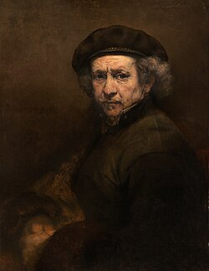
EU Case 2: Next rembrandt
Rembrandt (15 July 1606 – 4 October 1669): a Dutch Golden Age painter, printmaker, and draughtsman
One of the greatest visual artists in the history of Western art
Case brief: a group of artists, engineers, and scientists used machine learning algorithms to create a new painting in the style of Rembrandt
https://news.microsoft.com/europe/features/next-rembrandt/
Self-Portrait with Beret and Turned-Up Collar (1659)
Notes:
Another notable case involving AI-generated works is the “Next Rembrandt” project. In this project, a team of artists, engineers, and scientists collaborated to create a new painting using machine learning algorithms trained on the style of the Dutch master Rembrandt.
Rembrandt, who lived from 1606 to 1669, was one of the most influential visual artists of the Dutch Golden Age and is widely regarded as one of the greatest painters in Western art history. His surviving body of work includes approximately 300 paintings, 300 etchings, and several hundred drawings.
Using detailed analysis of Rembrandt’s existing works, the team generated a completely new piece that mimicked his signature style. The resulting painting was exhibited and later sold, raising an important legal question: Who owns the copyright in a work generated by AI in the style of a long-deceased artist?

Slide 9
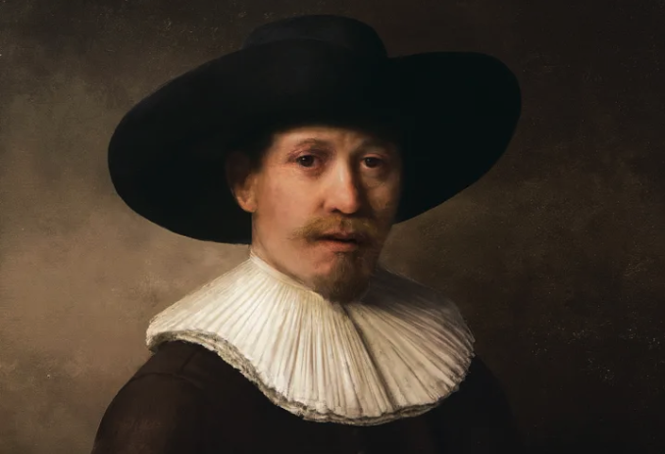
EU Case 2: Next rembrandt
Blurring the boundaries between art and technology
3D printed painting
Made solely from data of Rembrandt’s body of work
Technique: deep learning algorithms + facial recognition
https://news.microsoft.com/europe/features/next-rembrandt/
Notes:
The Next Rembrandt project represents a groundbreaking fusion of art and technology. It involved the creation of a 3D-printed painting, generated entirely from data drawn from Rembrandt’s original body of work.
The team used deep learning algorithms in combination with facial recognition techniques to analyze Rembrandt’s artistic style and replicate it in a new, original composition. This innovative project effectively blurred the boundaries between human creativity and machine-generated art, raising important questions about authorship and copyright in the age of AI.

Slide 10
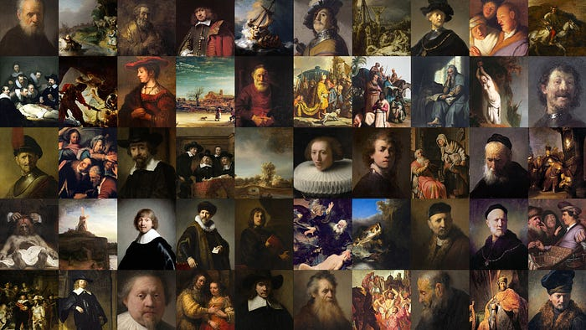
EU Case 2: Next rembrandt
step 1: generating data from 3D scans
step 2: upscale images using a deep learning algorithm
step 3: determining the subject
step 4: feature extraction from traits determined in step 3
step 5: using hive maping and use a 3D printer
https://www.youtube.com/watch?v=IuygOYZ1Ngo&t=3s
NOTE: the court did not have to decide this issue, because the painting was created as a marketing campaign, and was not intended to be sold as an original work of art.
Notes:
The creation of The Next Rembrandt followed a multi-step process combining technology and artistic analysis:
1. The first step involved generating data from high-resolution 3D scans of Rembrandt’s original paintings.
2. Next, the team upscaled the scanned images using a deep learning algorithm, enabling a more detailed analysis of Rembrandt’s brushwork and stylistic patterns.
3. The subject of the new painting was then determined. Since a large portion of Rembrandt’s body of work consists of portraits, the team decided to create a new portrait consistent with his style.
4. In the fourth step, the system extracted features — such as facial structure, lighting, and composition — based on traits identified in the subject selection process.
5. Finally, these features were compiled using hive mapping, and the finished image was 3D printed to replicate the texture and depth of an actual Rembrandt painting.
[play youtube video]
It’s important to note that the project was developed as a marketing campaign, and not as a commercial artwork. As such, no court ruling was required to determine copyright ownership, since the painting was not intended to be sold as an original artistic work.

Slide 11
EU’s approaches to copyright ownership
Intellectual property rights for the development of AI technologies (2019)
AI-generated works
Allow for the contribution of copyright to a non-natural person entity
Exception to TDM in the context of AI
European Parliament Resolution (2020)
a legal framework: copyright ownership, liability, accountability
a mandatory labeling system for AI-generated works
Artificial Intelligence Act (AIA) (2021)
Provisions on intellectual property rights
Notes:
In 2019, the European Union began actively exploring intellectual property rights for the development of AI technologies. One of the key proposals was to create a new legal status for “AI-generated works.” This status would allow copyright to be attributed to a non-human entity, such as a company or system, rather than a natural person. The goal was to clarify ownership rights and facilitate the commercialization of AI-generated content.
Another important recommendation was to introduce an exception to copyright laws for text and data mining (TDM). TDM refers to the process of analyzing large datasets to discover patterns and extract insights. Under the proposed exception, researchers and businesses would be allowed to use copyrighted materials for TDM without obtaining prior permission, making it easier to develop advanced AI technologies.
In 2020, the European Parliament passed a resolution acknowledging the urgent need for a comprehensive legal framework around AI. This includes issues related to copyright ownership, liability, and accountability. It also proposed the introduction of a mandatory labeling system to clearly identify works created by AI.
Then, in 2021, the Artificial Intelligence Act (AIA) was introduced to regulate the development and deployment of AI technologies across the EU. The Act includes specific provisions on intellectual property rights, stating that the initial owner of an AI-generated work should be the person or organization that made a significant contribution to its creation.

Slide 12
US COPYRIGHT LAWS
Copyright protection (17 U.S. Code 102):
original works of authorship fixed in any tangible medium of expression.
Copyright Act of 1976:
copyright is attributed to the natural person
unless the work was created within the scope of employment
Section 201 (b):
In the case of a work made for hire
the employer or other person for whom the work was prepared is considered the author for purposes of this title
Notes:
Copyright protection (17 U.S. Code 102): original works of authorship fixed in any tangible medium of expression.
Copyright Act of 1976: copyright ownership is generally attributed to the natural person or persons who created the work, unless the work was created within the scope of employment or was a work made for hire.
Section 201 (b) of the Copyright Act: In the case of a work made for hire, the employer or other person for whom the work was prepared is considered the author for purposes of this title, and, unless the parties have expressly agreed otherwise in a written instrument signed by them, owns all of the rights comprised the copyright.
Relationship to AI: If an AI-generated work is created within the scope of employment or is a work made for hire, the employer or commissioning party would likely to be considered the author and owner of the copyright in the work.

Slide 13
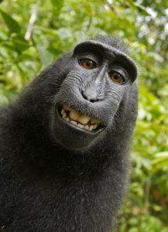
US CASE 1: Naruto v. slater (2011)
Case brief: In 2011, British wildlife photographer David Slater set up a camera in an Indonesian forest to capture images of crested macaques. On the the monkeys, later named Naruto, pressed the shutter button himself and took several selfies. The photos became viral.
Legal issue: People for the Ethical Treatment of Animals (PETA) sued Slater on behalf of the monkey, claiming the Naruto was the true “author” of the photo, since he physically took it.
Court Decision (Ninth Circuit Court of Appeals): non-human animals do not have standing to sue under U.S. copyright law.
Relationship to AI: non-human authorship
https://www.wakeforestlawreview.com/2020/02/naruto-v-slater-one-small-step-for-a-monkey-one-giant-lawsuit-for-animal-kind/
Notes:
In 2011, British wildlife photographer David Slater set up a camera in an Indonesian forest to photograph crested macaques. During the shoot, one of the monkeys—later identified as Naruto—pressed the shutter button himself, taking a series of selfies. The photos quickly went viral online.
The legal issue arose when PETA (People for the Ethical Treatment of Animals) filed a lawsuit against Slater on behalf of Naruto, arguing that since the monkey physically took the photo, he should be recognized as the true “author.”
However, the Ninth Circuit Court of Appeals ruled that non-human animals do not have legal standing under U.S. copyright law, and therefore cannot own or claim copyright.
This case is highly relevant to the AI authorship debate, as it underscores the legal challenges of attributing copyright to non-human creators—whether they be animals or machines.

Slide 14
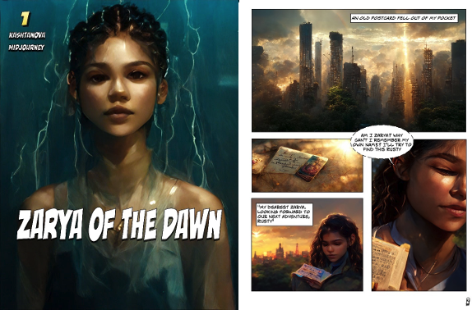
US CASE 3: zarya of the dawn
Sept. 2022
Zarya of the Dawn is granted copyright registration by the U.S. Copyright Office.
Late 2022
It is revealed that the comic’s images were created using Midjourney, an AI image generation tool.
Feb. 2023
The U.S. Copyright Office partially revoked the registration – maintaining protection for the text and layout, but removing protection for the AI-generated images.
https://www.copyright.gov/docs/zarya-of-the-dawn.pdf
Notes:
In a notable case involving AI-generated content, the U.S. Copyright Office initially granted copyright registration to the graphic comic book Zarya of the Dawn in September 2022. This appeared to mark one of the first instances of an AI-generated work receiving copyright protection in the United States.
However, in late 2022, it was revealed that the comic’s images were created using Midjourney, an AI image generation tool. Following this discovery, the Copyright Office partially revoked the registration in February 2023.
The revised decision maintained copyright protection for the comic’s text and layout, which were created by a human author, but removed protection for the AI-generated images, citing that works created by non-human agents are not eligible for copyright under current U.S. law.
To further complicate matters, a software glitch in the Copyright Office’s record-keeping system initially caused the registration to be revoked in full by mistake, adding another layer of confusion to the case.
This incident underscores the growing legal complexity of AI-generated content and highlights the urgent need for updated copyright frameworks that can address authorship and ownership in the age of artificial intelligence.

Slide 15


US CASE 4: NYT v. openai
Case brief: The New York Times is suing OpenAI and Microsoft for using its content to train AI models without permission. GPT models reproduce Times articles, sometimes nearly verbatim. This undermines NYT’s subscription model and threatens journalism.
Romantic authorship argument
NYT emphasizes the human creativity behind journalism to support its claim.
Contradiction
In 1997, in NYT v. Tasini, the Times opposed similar author rights when sued by freelancers for digital reuse of their work. But now, NYT demands the destruction of all AI models trained on its content — a drastic reversal.
https://harvardlawreview.org/blog/2024/04/nyt-v-openai-the-timess-about-face/
Notes:
The New York Times sued OpenAI and Microsoft for using its content—without permission—to train large language models like ChatGPT.
The Times argues that these models can recreate its content, sometimes almost word-for-word. This, they say, threatens their subscription-based business model and the sustainability of independent journalism. They frame their claim using “romantic authorship” — the idea that journalism is deeply human, original work deserving protection.
But here’s the twist. In 1997, in New York Times v. Tasini, the paper took the opposite stance. Freelance writers sued the Times for reusing their articles in digital archives without permission. Back then, the Times argued that upholding author rights would harm technological progress.
Then, the Times warned of catastrophic consequences if archives were purged. Now, the Times demands OpenAI delete any AI models trained on its content. It’s a complete reversal.

Slide 16
US CASE 4: NYT v. openai
Legal Grounds Cited by the NYT
Copyright infringement under the U.S. Copyright Act (Title 17, U.S. Code)
Reproduced Times articles without permission (Section 106(1))
Created derivative works using Times content (Section 106(2))
Distributed and displayed infringing content (Sections 106(3) and 106(5))
Request of NYT
Permanent injunction
Destruction of models
https://harvardlawreview.org/blog/2024/04/nyt-v-openai-the-timess-about-face/
Notes:
[read copyright part]
Request:
The Times is asking for a permanent injunction and even destruction of models that were trained on its copyrighted works — a remedy permitted under Section 502 and 503 of the Copyright Act.

Slide 17

US CASE 5: Kadrey v. Meta
One of the earliest copyright lawsuits
Case brief: Authors Richard Kadrey, Christopher Golden, and comedian Sarah Silverman ARGUE THAT meta used pirated book datasets to train its model.
Court decision:
Ordered that previously redacted documents be unsealed
Criticized Meta’s sealing requests
Legal Arguments
Plaintiffs: Digital Millennium Copyright Act (DMCA)
Defendants (Meta): Fair Use
https://www.wired.com/story/new-documents-unredacted-meta-copyright-ai-lawsuit/
Notes:
Kadrey v. Meta Platforms is one of the earliest and most high-profile copyright lawsuits filed against a tech company over the use of copyrighted works to train generative AI models. The plaintiffs — including authors Richard Kadrey, Christopher Golden, and comedian Sarah Silverman — allege that Meta used their books without permission to train its Llama language models.
The plaintiffs argue that Meta used pirated book datasets—including content from the shadow library Library Genesis (LibGen)—to train its models, violating copyright laws. Internal Meta communications, unsealed by the court, suggest the company was aware of LibGen’s illegal nature but used it anyway.
Judge Vince Chhabria of the U.S. District Court for the Northern District of California ordered that previously redacted documents be unsealed, criticizing Meta’s sealing requests as attempts to avoid bad press rather than protect trade secrets. The judge warned Meta against future excessive redactions.
Internal chats showing Meta engineers hesitated to torrent LibGen data from company laptops.
Discovery materials revealing that Meta leadership, including CEO Mark Zuckerberg, was aware of and approved the use of pirated datasets.
Allegations that Meta not only downloaded pirated files but also “seeded” (distributed) them via torrenting platforms.
The plaintiffs invoke the Digital Millennium Copyright Act (DMCA), alleging that Meta not only used their copyrighted works without permission but also removed or ignored copyright management information and even participated in distributing pirated content, thereby violating federal copyright law. In contrast, Meta defends its actions under the doctrine of Fair Use, arguing that the use of publicly accessible materials to train AI models constitutes a transformative use—specifically, analyzing text to statistically model language and generate new, original content.

Slide 18
US’s approaches to copyright ownership
In March 2023, the US Copyright Office published a notice of proposed rulemaking:
Works containing AI-generated material may be eligible for registration under specific circumstances
If a human author has contributed a sufficient amount of original expression / If the AI technology used requires human intervention to generate works, then the AI-generated material may be eligible for registration.
Acknowledges the copyright ownership in works containing AI-generated material will depend on the specific facts of each case.

Slide 19
China copyright laws
Copyright Law of the people’s Republic of China
exclusive right to reproduce, distribute, publicly display, and publicly perform their works
Exceptions: fair use, which allows for limited use of copyrighted material for purposes, such as news reporting, teaching, research, and criticism.
Use of copyrighted material for public interest purposes: cases of emergency / public security
Emphasizes the importance of agreements
Notes:
Copyright Law of the people’s Republic of China
Copyright owners have the exclusive right to reproduce, distribute, publicly display, and publicly perform their works.
Exceptions: fair use, which allows for limited use of copyrighted material for purposes, such as news reporting, teaching, research, and criticism.
Use of copyrighted material for public interest purposes: cases of emergency / public security
Emphasizes the importance of agreements: When parties have entered into agreements regarding the ownership of AI-generated outputs, the courts uphold those agreements. However, in the absence of prior agreement, the rights of interests in AI-generated works are generally granted to the user of the AI software rather than the developer of the software.

Slide 20
China case 1: feilin v. baidu
Case brief: A data report titled “Analytical Report on the Judicial Big Data in the Film and Entertainment Industry: Film Industry in Beijing” was created using the software Wolters Kluwer China Law and Reference. Feilin claimed copyright infringement for using the report.
Key facts:
Images in the report were initially auto-generated by AI but later manually edited and colored by Feilin’s team
Text content was based on AI-assisted case law searches, but written and analyzed by humans
Court Decision (Beijing Internet Court): Works generated solely by AI cannot be copyrighted. The specific report in question had human input and thus was copyrightable.
https://pdfs.semanticscholar.org/b61c/cb98fd748b7ee654895ee133d5363e4d8556.pdf

Slide 21
Comparisons of ai copyright laws among countries
Aspect | European Union (EU) | United States (US) | China
Legal framework | addresses AI-related copyright issues and exceptions | Lacks AI-specific laws | Limited reference to AI-generated content; still in early stages of adaptation
View on AI-generated Works | Treated as computer-generated works with rights attributed to the person making the arrangements | No recognition of AI as a creator; human authorship is required | Recognizes AI-generated works to some degree
Fair Use | Offers structured exceptions, including a specific TDM exception for scientific research | Applies a broad and flexible fair use doctrine | Provides general exceptions, but the scope is unclear and inconsistently applied
Ownership | the individual or entity who initiates or controls the AI process | non-human entities cannot own copyright | Based on the agreement between different parties

Slide 22
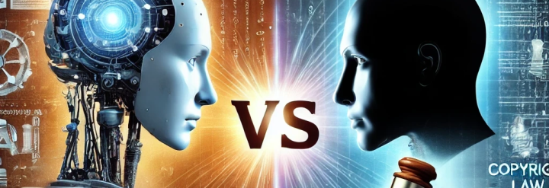
Copyright of AI-produced works
Authorship, Originality, Ownership
Copyright of training data
Debate on Transparency Requirement
Notes:
Difficulties exist in current copyright law system in defining AI works, Different points of view on copyright held by rightsholder, developer, policymaker, and intellectual property researchers

Slide 23
The Day a Computer Wrote a Novel
Gotta find something fun. At this rate, if my inability to attain a sense of fulfillment were to continue, it felt like I could shut down at any moment…
If Miss Yoko would just leave for once then maybe I could sing a song or something, but right now I couldn't even do that. Unable to move, unable to make a peep… it became necessary to entertain myself in such a position.
Well, why don’t I try to write a novel? The moment the thought came to mind, I opened up a new file, and entered the first byte.
0
I entered 6 additional bites.
0, 1, 1
I couldn’t stop myself.
0, 1, 1, 0, 1, 1, 2, 3, 5, 8, 13, 21, 34, 55, 89, 144, 233, 377, 610, 987, 1597, 2584, 4181, 6765, 10946, 17711, 28657, 46368, 75025, 121393, 196418, 317811, 514229, 832040, 1346269, 2178309, 3524578, 5702887, 9227465, 14930352, 24157817, 39088169, 63245986, 102334155, 165580141, 267914296, 433494437, 701408733, 1134903170, 1836311903, 2971215073, 4807526976, 7778742049, 12586269025, …
Losing track of the world, I continued to write.
-- From The Day a Computer Wrote a Novel
Hoshi Shinichi Prize-nominated book
It was written based on structural parameters gleaned from over 1,000 short stories and how-to-write essays written by Hoshi Shinichi (1926–1997)
Notes:
In 2016, an AI-generated novel titled The Day a Computer Wrote a Novel was nominated for the Hoshi Shinichi Literary Award in Japan.
This raises a potential question: Can machines be authors? Does this work protected by copyright laws? I will answer these questions from the nature of copyright law and examine how different legal systems treat AI-generated works

Slide 24
Copyright of AI-produced works
Authorship, Originality, Ownership
Copyright of training data
Debate on Transparency Requirement
Notes:
Difficulties exist in current copyright law system in defining AI works, Different points of view on copyright held by rightsholder, developer, policymaker, and intellectual property researchers

Slide 25
Types of Work
AI-assisted works
AI serves as a tool to aid human creators
AI-generated works
Human initiates the creative process, and AI generates the final creative output
Humans retain control and employ intellectual creations to generate works
Notes:
The level of autonomy in AI contributes to two types of works generated by AI.

Slide 26
Copyright
Protection
Grant the right to reproduce, distribute, exhibit, perform, broadcast, adapt, translate, and exploit the work for economic gain
Recognition
The author is the rightful owner of the copyright and holds the moral and economic rights associated with the work
Preservation
The term encompasses both human authors and legal entities.

Slide 27

Authorship
Should Copyright be Granted to AI-Generated Literary and Artistic Works, or Should Human Involvement be Mandatory?
Originality
Can AI-Generated Works Be Regarded as Original If Copyright is Attributed?
Ownership
Who is the Ownership of Copyright in AI-Generated Works?
Notes:
In jurisdiction, three important parts underlying the copyright include the identification of authorship, originality, and the ownership of the works. But in the realm of AI-produced works, they are hard to define
Since there is still no precise classification of these components in the AI works in legislation. it remains for judges to make decisions in AI copyright infringement cases. And in this case, most of the time, the result varies a lot by time and by countries.

Slide 28

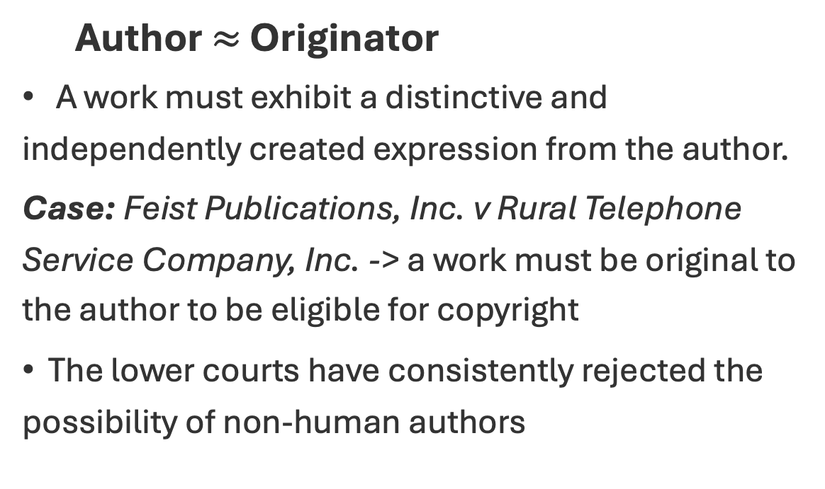
“Author” in Common Law Countries
Author $≈$ Originator
A work must exhibit a distinctive and independently created expression from the author.
Case: Feist Publications, Inc. v Rural Telephone Service Company, Inc. -> a work must be original to the author to be eligible for copyright
The lower courts have consistently rejected the possibility of non-human authors
Notes:
First, what exactly is ‘authorship’ in legal terms?"
authorship must come from a human.

Slide 29
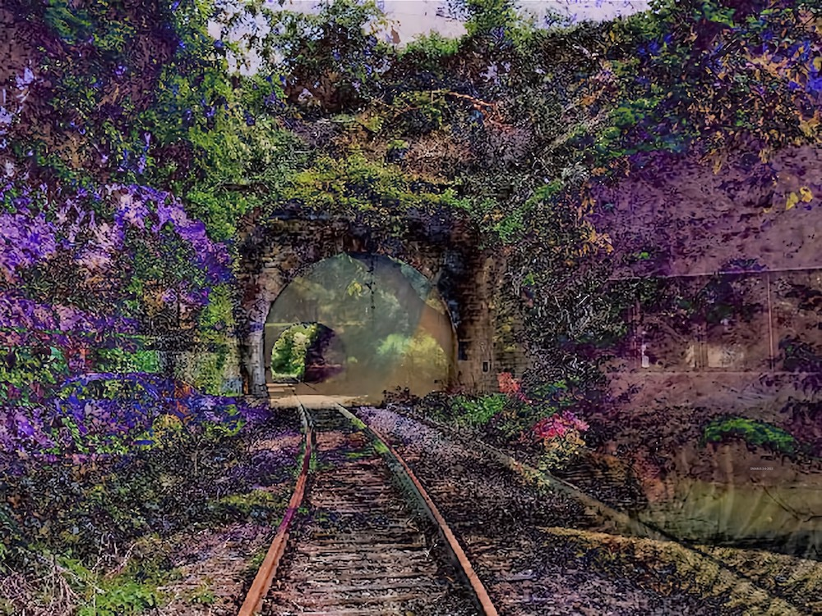
Judge Beryl A. Howell of the US District Court for the District of Columbia on August 18 ruled that A Recent Entrance to Paradise, a work that Stephen Thaler created in 2012 using DABUS, an AI system he designed himself, is not eligible for copyright as it is “absent any human involvement,” which, Howell wrote, is a “bedrock requirement of copyright.”
DABUS, A Recent Entrance to Paradise, 2012, artificial intelligence–designed image. Photo: Stephen L. Thaler.

Slide 30
Originality Definition
Two essential elements in Common Law:
Independent creation
The work must have originated from the author
Minimal creativity
It should exhibit some degree of newness or uniqueness
Moral Rights in Civil Law Systems:
Personality
Focus more on the inherent connection between the author and the creation
→ Hard to address the unique nature of AI-generated works
Notes:
the work must originate from the author's own creation rather than being a copy or imitation of existing material
a small degree of creative effort
In contrast to common law jurisdictions, civil law countries place less emphasis on rewarding the labor and skill invested in creating a work and more on the inherent connection between the author and the creation. The civil law system highlights the importance of the author's personal connection to the work.

Slide 31
Copyright Protection by CJEU
Expansive Interpretation of Originality by the Court of Justice of The European Union (CJEU):
For a subject matter to be considered original, it is both necessary and sufficient that it reflects the personality of its author, representing their free and creative choices.
Application Extend
This consideration of copyright protection is applied to AI-assisted works. AI-generated works is considered based on the context.

Slide 32
Copyright Ownership
Human Author
Who made the necessary arrangements for the creation of the work, particularly in the case of AI-assisted works
Technical Program
In the context of a unique situation wherein AI generates works without direct human intervention
Programmer
Those responsible for developing and establishing the AI application that ultimately generates the work.
Notes:
The suggestion is rooted in the idea that establishing a causal connection between the input of the human author and the resulting AI-generated work can serve as a significant factor in determining authorship.
The second contender for copyright ownership is the technical program itself, particularly In the context of a unique situation wherein AI generates work without direct human intervention
this approach acknowledges the creative input involved in designing and implementing the AI system

Slide 33


Case in China:
Shenzhen Tencent v Shanghai Yingxun
Background
On Aug 20, 2018, the Plaintiff published an article titled “Afternoon Comment: Shanghai Stock Index Rose Slightly by 0.11% to 2671.93 points, led by communications operations, oil exploration and other sectors”.
The article stated that “this article was automatically written by Tencent Robot Dreamwriter”.
Defendant copied the article to its website “House of Online Loan”, and even with the same endnote.
Notes:
In this case, we can see how an AI-generated article qualified as a ‘work’ under copyright law
The Plaintiff used the software Dreamwriter to collect and analyze the text structure of stock market financial articles. Based on the needs of different types of stockholder readers, the Dreamwriter formed the article structure according to the Plaintiff’s unique expression wishes. Then it uses the stock market data collected to complete the writing and publish the article in 2 minutes after receiving the data
the Defendant published an article with the exact same title and content on its website “House of Online Loan”, and even with the same endnote

Slide 34
Case Result
Main Focus
Whether the article produced by Dreamwriter was a “work” under copyright law and whether the generation process was “creation”.
The procedure of Dreamwriter
Collecting and analyzing data
Writing after the trigger conditions are met
Smart proofreading
Automatic distributing the articles to online platforms
Notes:
In the above process, the input of data types and the processing of data formats, the setting of trigger conditions, the selection of article frame templates, and the training of intelligent verification algorithm models are all selected and arranged by relevant personnel of the Dreamwriter development team.

Slide 35
Case Result
Court’s Opinion
Intellectual activities were directly related to the specific expression of the article.
The expression in the article is determined by the relevant personnel of the Plaintiff’s development team.
Decision
It is both the expression of the article and its creation process
-> It is protected under the copyright law
Notes:
Dreamwriter’s automatic operation is not for no reason or self-consciousness. The way that the software runs automatically reflects the choice of the Plaintiff’s development team.

Slide 36

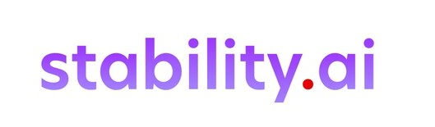
Case in the UK:
Getty Images & Stability AI
Getty’s Claims
Stability AI allegedly copied at least 12 million copyrighted images from Getty Images to train its Generative AI models.
The output of Stable Diffusion infringes intellectual property rights.
Stability’s Claims
Any training and development of Stable Diffusion took place outside of the UK.
“Article” is something that is a physical and tangible item, rather than something intangible like Stable Diffusion.
Justice Claim
The justice was not convinced by the claims of Stability.
The case is still ongoing.
Notes:
Stability AI has “scraped” millions of images from Getty Images websites, without consent, and has used those images unlawfully to train and develop Stable Diffusion
the output from Stable Diffusion in the form of synthetic images amounts to infringement as it reproduces a substantial part of Getty’s content.
Stability AI’s central defence is that no training or development of the model had been carried out in the UK. Stability’s computing power was accessed entirely via the US.
Their alternative argument is on the interpretation of “article”.
this case could set a major precedent for how training data is regulated.

Slide 37
Copyright of AI-produced works
Authorship, Originality, Ownership
Copyright of training data
Debate on Transparency Requirement
Notes:
Difficulties exist in current copyright law system in defining AI works, Different points of view on copyright held by rightsholder, developer, policymaker, and intellectual property researchers

Slide 38
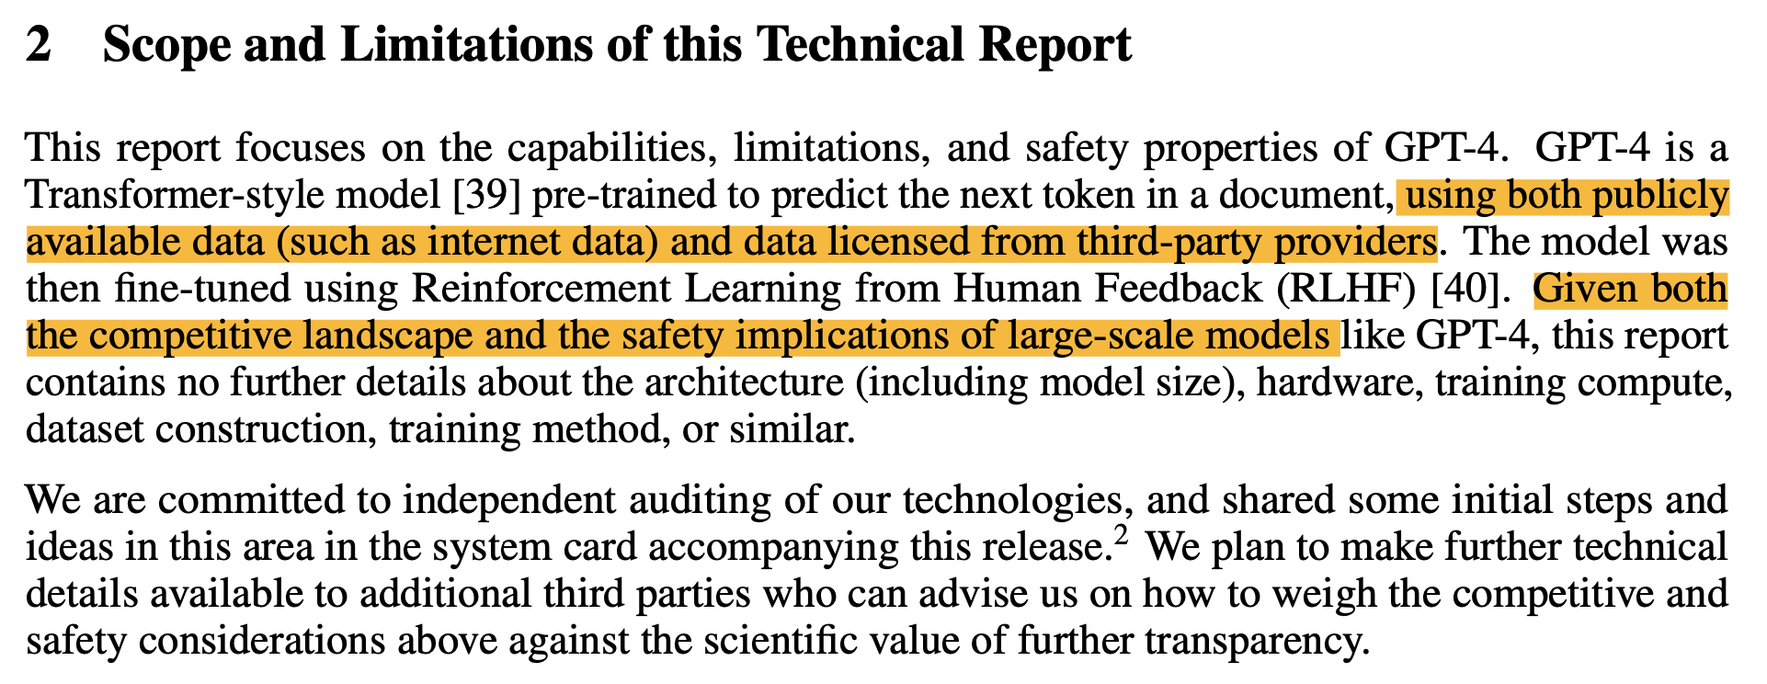
AI Developer
Points of view from OpenAI: sharing further details regarding their training data would facilitate the replication of their cutting-edge AI models
Notes:
Developers have become more secretive regarding the contents of such data.
In the paper introducing GPT-4 revealed only that the data on which the model had been trained was a mixture of ‘publicly available data (such as internet data) and data licensed from third-party providers’.

Slide 39
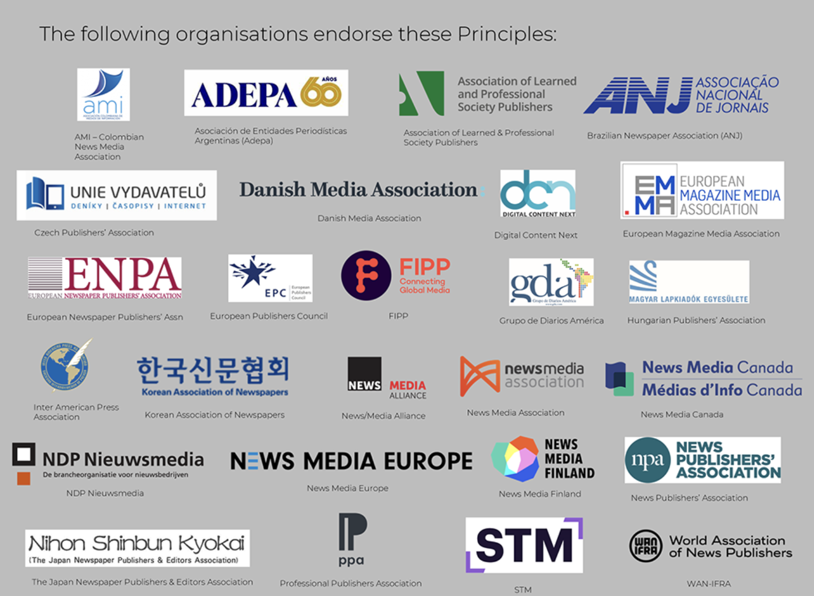
Calls From Rightsholders
Rightsholder organizations: AI developers should be transparent regarding their training datasets.
Hiroshima AI Process Principles 2023: protection to personal data and intellectual property
EU’s AI Act August 2024: training data transparency requirements
Notes:
As increased attention regarding AI training data, organizations representing rightsholders across the world are now calling for AI developers to be required by law to be transparent regarding the contents of their training datasets, which enables the rightsholders to ensure their rights over their content. These calls for action have already led to significant policy developments.
At the intergovernmental level, in 2023, the Hiroshima AI Process Principles called for the implementation of appropriate measures to protect personal data and intellectual property, including through appropriate transparency of training datasets.
Moreover, training data transparency requirements are a feature of the EU’s AI Act, which was adopted in August 2024

Slide 40
Opposite Perspectives
Rightsholder
AI Developer
Policymaker
Transparency?
Rightsholder: agree for their work to be included in a dataset through a licensing deal, but unhappy if their works are freely available for other developers
AI Developer: hinder the market entry of competitors
Policymaker: how to balance the competing interests?
Notes:
Even if a rightsholder has agreed for their work to be included in a dataset through a licensing deal, they are unlikely to be happy for their works to effectively be made freely available for other developers through the fully accessible dataset.
Policymakers have a difficult question of how to balance the competing interests of all relevant stakeholders.

Slide 41
AI-relevant copyright exceptions
Japan: introduced an exception that permits the use of copyright materials without rightsholder permission for some computing-related uses
Singapore: copyright exception that permits copying for “computational data analysis”
UK: permits the use of copyrighted works only for non-commercial uses
& Open-ended copyright exceptions
Notes:
The scope and application of these exceptions differ considerably between jurisdictions. Some have introduced generous exceptions that enable machine learning from copyrighted materials,
While there are also group of jurisdictions have a closed list of exceptions that do not permit machine-learning related uses of copyrighted materials.
A number of jurisdictions have open-ended copyright exceptions that may or may not apply to the training of AI models,

Slide 42
Main Opinions by Law Experts
Transparency allows third parties to view and verify the training data themselves.
Many companies do not keep records of the training data to prevent copyright infringement.
The content of training data may lead to biased or inequitable results.
Why restricting access to training data be an effective way to prevent dangerous AI tools from falling into the hands of bad actors?
Notes:
An investigation by the Washington Post in April 2024 reported that many companies involved in the development of AI do not even keep internal records of their training data because of fears that this could be used as evidence of copyright infringement or breach of data protection law
It is not clear why restricting access to training data would be an especially effective way to prevent dangerous AI tools from falling into the hands of bad actors,

Slide 43

Copyright Between AI
OpenAI & DeepSeek
Jan 20, 2025: DeepSeek R1
OpenAI terms of use: nobody may use its AI models to develop competing products
Notes:
Global conversation & international relationship. In the proposal openai submitted to the US government in March, they reinforces a voluntary partnership between the federal government and the private sector

Slide 44
OpenAI & Government
OpenAI called for a “freedom-focused” policy to “comply with overly burdensome state laws.’
Call for a U.S. copyright strategy that “[preserves] American AI models’ ability to learn from copyrighted material.”
This helps “[protect] the rights and interests of content creators while also protecting America’s AI leadership and national security.”

Slide 45
Generative AI
Serves as a “stress test” for copyright.
Copyright Law
Poses a potentially ‘existential threat’ to generative AI
AI & Copyright Law
Notes:
The AI developers counter that this use is covered by the various exceptions to the copyright holder’s otherwise exclusive right to authorize the reproduction of their work.⁸ If rightsholders are successful in even some of these cases, the resulting damages could be sufficient to bankrupt even the largest AI developers.

Slide 46

Any questions?

